Slide 1
The Bioeconomy and Glycoscience
Global Challenges Science Week
Université de Grenoble Alpes
Rodney Townsend
6th June 2019

Slide 2
Purposes of this talk
To suggest that this is a uniquely opportune time to be working on glycoscience and glycotechnology in Europe.
To outline how the EU and in particular Horizon Europe is presently thinking about the Bioeconomy as a solution to many current Global Challenges.
To describe some ways we can increase the profile of new glycoscience and glycotechnology with the general public and Governments within Europe.
To inform on how we can raise Research and Innovation funding for glycoscience and glycotechnology in the next decade within Europe.
To discuss some already identified ‘R&I’ challenges we must overcome in glycoscience and glycotechnology.

Slide 3
Main topics of the talk
The role of ‘Bioeconomy Europe’ and the core concept of “Sustainable Growth”.
What is “Innovating for Sustainable Growth”? – the concept explained.
Glycoscience and the glycotechnologies are essential to deliver the Bioeconomy Europe vision – how do we obtain the funding required? – SusChem and Horizon Europe.
Raising the profile of glycoscience and glycotechnologies in the EU, academe and industry – the mission of CarboMet.
Some examples of Research and Innovation [‘R&I’] priorities and challenges for glycoscience.
Conclusions – some actions we all need to take.

Slide 4

1: The role of ‘Bioeconomy Europe’ and the core concept of “Sustainable Growth”, as advocated by the EU…..
These are principles and concepts we need to
understand and then use to demonstrate to the EC ,
EU government and Member State governments
generally that the comparative current neglect of
glycoscience and glycotechnology must not continue….

Slide 5
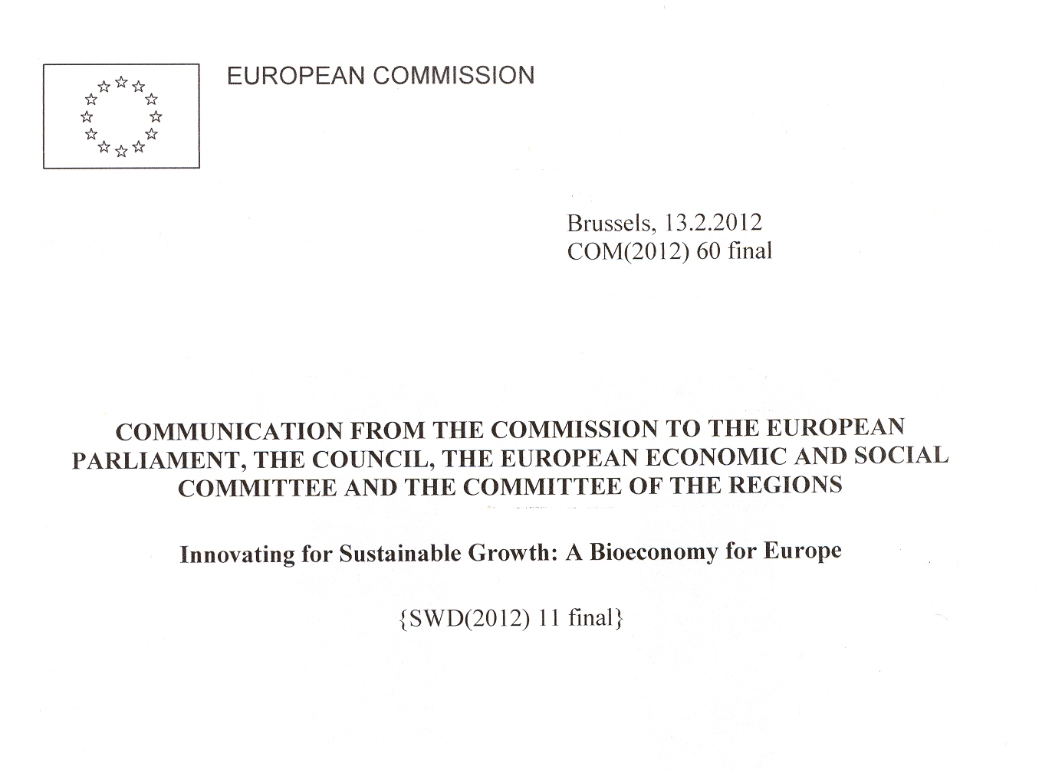
An Important Declaration of Principle by the EU on the Bioeconomy in 2012….

Slide 6
An assessment by the EU on the Relative Maturity
of the Fossil Feedstock Economy vis à vis the
Bioeconomy in 2012 - not a complete replacement
but a major rebalancing….
Fossil based chemical industry
Maturity gap
Characteristics for
fossil based fuels / chemistry
Economics of scale due to large installations / high throughput
Highly optimized processes
Well established supply chains
High production reliability
Characteristics for biorefineries
New technology / no track record
Compete on price and performance - not sustainability
New technology with new plant
Sound supply chain strategies utilising existing infrastructure
Industry maturity
Biorefinery industry
Foundation
Development
Expansion
Diversification
Maturity
Time
Notes:
The maturity gap is significant but so is the opportunity.
The key it to balance the new technology with the utilisation of existing assets and investment.
The IB Leadership Forum is the forum to accelerate and lead the way for UK plc into the world of Industrial Biotechnology.

Slide 7
A growing Initiative within Horizon 2020…..

Slide 8
A growing Initiative within Horizon 2020…..

Slide 9
The EU Bioeconomy continues to be a high priority within the currently developing Horizon Europe plans
(2021 to 2027). For example, see its recently published ‘Missions’:
Adaptation to Climate Change including Societal Transformation;
Cancer in all its forms;
Healthy Oceans and Natural Waters;
Carbon Neutral and Smart Cities;
Soil Health for Sustainable Food.
…..We will return to some of these topics in greater detail later when we consider the contributions that the glycosciences can make to building the EU Bioeconomy;
…..Innovative glycotechnology, and the new glycoscience backing it, is needed to provide solutions to the problems and challenges inherent in all five Missions..

Slide 10
An Important Declaration of Principle -
Innovating for Sustainable Growth …..

Slide 11
2: What is “Innovating for Sustainable Growth”?
We must comprehend what this phrase means to our
stakeholders if we are to be successful in our mission to
increase financial support for glycoscience from the
European Government, the Commission, Member
State Governments and European industry……

Slide 12
“Innovation”: the situation 10 years ago
MONEY
The so-called
“INNOVATION
WHEEL”
R
E
S
E
A
R
C
H
*TRL 1 to 6
Customer
Idea
Concept
Distribution
SAFER
FASTER
BETTER
CHEAPER
Prototype
INFORMATION
&
INVENTION
Sales
D
E
V
E
L
O
P
M
E
N
T
Product
Market
Service
Process
Manufacture
Market
Regs
*TRL 5 to 7
“Research and
Development is
all about turning
MONEY into KNOWLEDGE”
*TRL = Technology Readiness Level
KNOWLEDGE
© OCTEL 2003

Slide 13
“Innovation”: the situation 10 years ago
PROFIT
R
E
S
E
A
R
C
H
C
O
M
M
E
R
C
I
A
L
I
S
A
T
I
O
N
*TRL 1 to 6
Customer
Idea
Concept
Distribution
*TRL 7 to 10
Prototype
INFORMATION
&
INVENTION
INNOVATION
SAFER
FASTER
BETTER
CHEAPER
Sales
D
E
V
E
L
O
P
M
E
N
T
Product
Market
Service
Process
Manufacture
Market
Regs
*TRL 5 to 7
“INNOVATION is
all about turning
KNOWLEDGE into PROFIT”
*TRL = Technology Readiness Level
KNOWLEDGE
© OCTEL 2003

Slide 14
A limited definition of Innovation which puts very strong emphasis on profitability as the main, if not only, criterion….
So R & D is (apparently!) just about turning money into knowledge ….
…..and Innovation is (apparently?) just about turning knowledge into
nett profit as soon as possible ….
The logic behind this is that the prime justification to invest in (e.g.)
glycoscience must be whether it makes a profit soon….
….with environmental friendliness being a good extra ‘selling point'
but “not our problem” primarily.

Slide 15
A limited definition of Innovation which puts very strong emphasis on profitability as the main, if not only, criterion….
The “Innovation Wheel” is a myopic, one-dimensional view ….
…..it is NEITHER the view of most of industry today either (especially
those that have signed up to a responsible care commitment) NOR is
it the view of the European Parliament/European Commission….
….instead, the target must be “Sustainable Growth” with innovations
defined as products and concepts that change the world we live in,
by not only being financially viable but also beneficial to the health
and wellbeing of the of the whole ecosystem and fair to all sectors
of society.
For the bioeconomy, “good business sense” = ”sustainable growth”

Slide 16
Investing in an EU Bioeconomy…..
(Quote) - “the target must be ‘Sustainable Growth’ with innovations
defined as products and concepts that change the world we live in,
by not only by being financially viable but also beneficial to the health
and wellbeing of the of the whole ecosystem and fair to all sectors
of society…..”
This is a definition of “Innovation” very different from the previous one!
The issue now is how best to bring about innovation that grows
sustainably. …..
The view of the EU is that to invest in a Bioeconomy is one major way
to achieve this……
THE JOB FOR US IS TO CONVINCE THEM THAT THEY NEED US
TO ACHIEVE THEIR BIOECONOMY OBJECTIVES

Slide 17
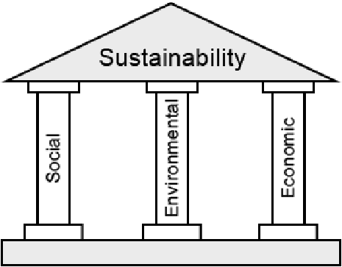
A well-known model of Sustainable Growth …
The famous “Three Pillar Model”….
….simple but arguably a bit
simplistic?….

Slide 18
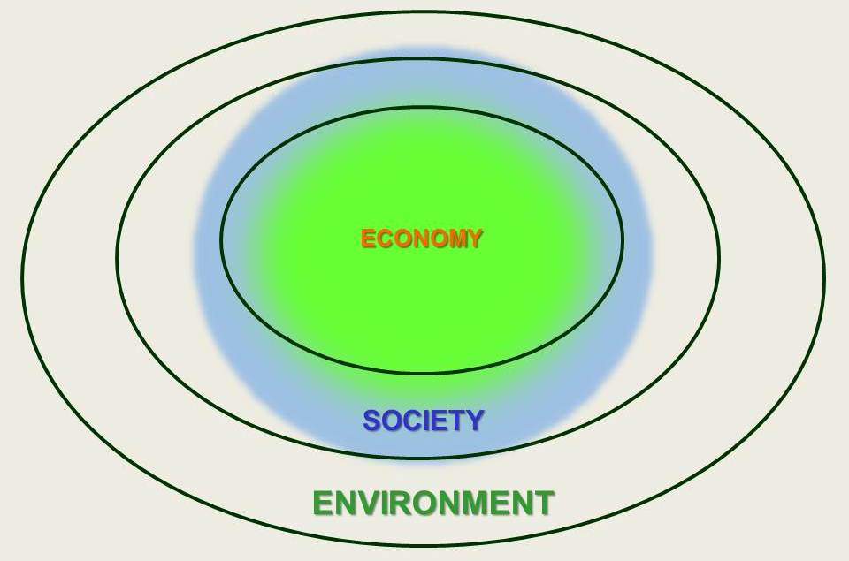
Better to regard the “three pillars” as concentric circles of operation which may mutually conflict….
“Ideal” operating
zone
…. but less ideal solutions
involving a compromise
may be the best we can do…
…and perhaps there may
not be a cost-effective
solution which ‘Society’
can afford because of
the long-term burden on
the environment...
Conflict resolution may involve difficult
choices but then the priorities MUST be:
Environment > Society > Economy

Slide 19
Innovating for Sustainable Growth
SOCIETALLY
ACCEPTABLE
Durable
Equitable
Durable
This inner domain
contains a subset of ideas and technical solutions that
could grow sustainably and without sacrificing the environment
Equitable
ECOLOGICALLY
SOUND
ECONOMICALLY
ROBUST
Viable
Viable

Slide 20
Innovating for Sustainable Growth
SOCIETALLY
ACCEPTABLE
Durable
Equitable
Durable
Equitable
….but
SYSTEMIC
solutions….
ECOLOGICALLY
SOUND
ECONOMICALLY
ROBUST
Viable
Viable

Slide 21
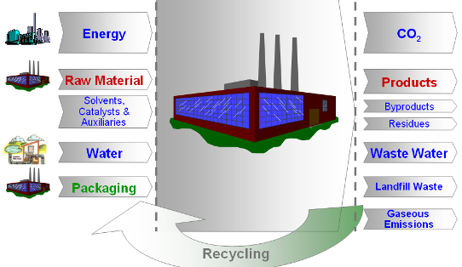
Innovating for Sustainable Growth: the technical solutions are SYSTEMIC – “The Circular Economy”
A big
T h e V a l u e C h a i n (s)
Processing Industries
Customer Side of the Value Chain
Societal Needs
Downstream Industries
Automotive
Transport
Construction
Furniture
Consumer Goods (P&G)
Quality of Life
Clean Environment
Low Carbon Society
Economic Prosperity
Raw Material Supplier Industries
End-Customers
Pharma
Crop Protection
Consumer Goods
Biotech
Pulp and Paper
Food ?
Mining ?
“THE CIRCULAR ECONOMY”
Big challenges, requiring systemic, bold solutions…
Bioeconomy and Glycoscience

Slide 22
Suppose the best we can do is this?….
SOCIETALLY
ACCEPTABLE
Durable
Equitable
Durable
Equitable
ECOLOGICALLY
SOUND
ECONOMICALLY
ROBUST
Viable
Viable

Slide 23
Then we change the goalposts and level
the playing field!….
SOCIETALLY
ACCEPTABLE
Durable
Equitable
Durable
Equitable
ECOLOGICALLY
SOUND
ECONOMICALLY
ROBUST
Viable
Viable

Slide 24
A long term partnership……
Moving the goal posts – this is REGULATION
Levelling the playing field – these can be FISCAL MEASURES
…both these require LEGISLATION
…..i.e., the EC acting as PARTNERS WITH INDUSTRY, OURSELVES
and OTHER INTERESTED PARTIES…..
….because the problems are SYSTEMIC and indeed INTERNATIONAL
....SO LONG TERM COMMITMENT IS THE ONLY SOLUTION

Slide 25
3: Both glycoscience and glycotechnology are essential to deliver the Bioeconomy Europe vision – but how do we raise the funding required?
We believe that new glycoscience and
glycotechnology are essential to develop
the EU Bioeconomy –but do the funders?
It is they who will provide the means to
realise our vision. Belief is not the issue! –
we must prove our proposition with hard,
evidence-based data and scientific logic…

Slide 26
Glycoscience research: how do we obtain the funding required within the EU Bioeconomy?
3.1: We must show that our glycotechnology advocacy coincides with those of
key industries that influence EU Bioeconomy funding priorities for the years
2021 to 2027. A key body which Is empowered to do this is “SusChem”…….
“SusChem ETP” stands for the “European Technology Platform for Sustainable Chemistry and Biotechnology”, supported financially and in-kind by Cefic and EuropaBio;
It was set up by the European Commission in 2004-5 using start-up money from the EC of ~€2 million to recommend research and innovation funding priorities in sustainable chemistry and biotechnology research (TRL1 to 6);
It is led by industry (European SMEs to large corporations) in concert with academia and meets regularly with key Commission officials & the European Parliament. It also operates in parallel at the national level in many European Member States as well as affiliated countries;
THROUGH SUSCHEM’S SUCCESSFUL ADVOCACY SUSTAINABLE CHEMISTRY AND BIOTECHNOLOGY HAS OBTAINED BILLIONS OF EUROS R&I SUPPORT SINCE ITS INCEPTION.
SusChem obtained at least € 6 billion for sustainable chemistry and biotechnology research through Framework Programme 7 with substantial additional funding from industry [2007 to 2014]
As well as continuing this level of support through Horizon 2020 SusChem helped to shape the EC’s funding programme (Horizon 2020) from as early as 2010 to form “SPIRE” and “BBI” Public-Private Partnershps [‘PPSs’]
SPIRE [“Sustainable Processing In Resource Efficiency” ] has formed a backbone Public-Private-Partnership throughout Horizon 2020 (worth ~€1 billion) alongside another partnership called BBI [“Bio-Based Industries”]. also worth ~€1billion.
SusChem is now preparing a new Strategic Innovation and Research Agenda as a bid to the Commission with an increased emphasis on the Bioeconomy and Health, Food and Agriculture…..

Slide 27
Some examples where SusChem considers where more investment could benefit the
EU Bioeconomy over the next decade…..
Biomaterials and Biopolymers
The Circular Economy in the Bioeconomy
Bio-based Feedstocks
“Industry 4.0” for Stratified Medicine Production
Bio-informatics and Data Analytics in Manufacture
New Metrology Requirements
Soft Sensor Technology
Novel Biologics for Medical care and Wellbeing
Novel Vaccine Technology
Human Skin and Gut Microbiome
Sustainable Food Packaging
Healthy Eating, Foods and Prebiotics
Soil Remediation, Engineering and Metagenomics
Harvesting Sustainably Novel Biomolecules from the Sea
Synthetic Biology and the Biocatalysis/Chemocatalysis Interface

Slide 28
Glycoscience research: how do we obtain the funding required within the EU Bioeconomy?
SusChem is therefore preparing a new Strategic Innovation and Research Agenda as a bid to the Commission with an increased emphasis on the Bioeconomy in Health, Food and Agriculture in particular….
Currently considering advocacy in the following areas relevant to us:
Biomaterials and Biopolymers
The Circular Economy
Bio-based Chemicals and Feedstocks
The Digital Economy
New Metrology Requirements in Diagnosis and Manufacture
The Human Skin and Gut Microbiome
Sustainable Food Packaging
Healthy Eating, Foods and Prebiotics
Soil Remediation, Engineering and Metagenomics
Synthetic Biology and Biocatalysis

Slide 29
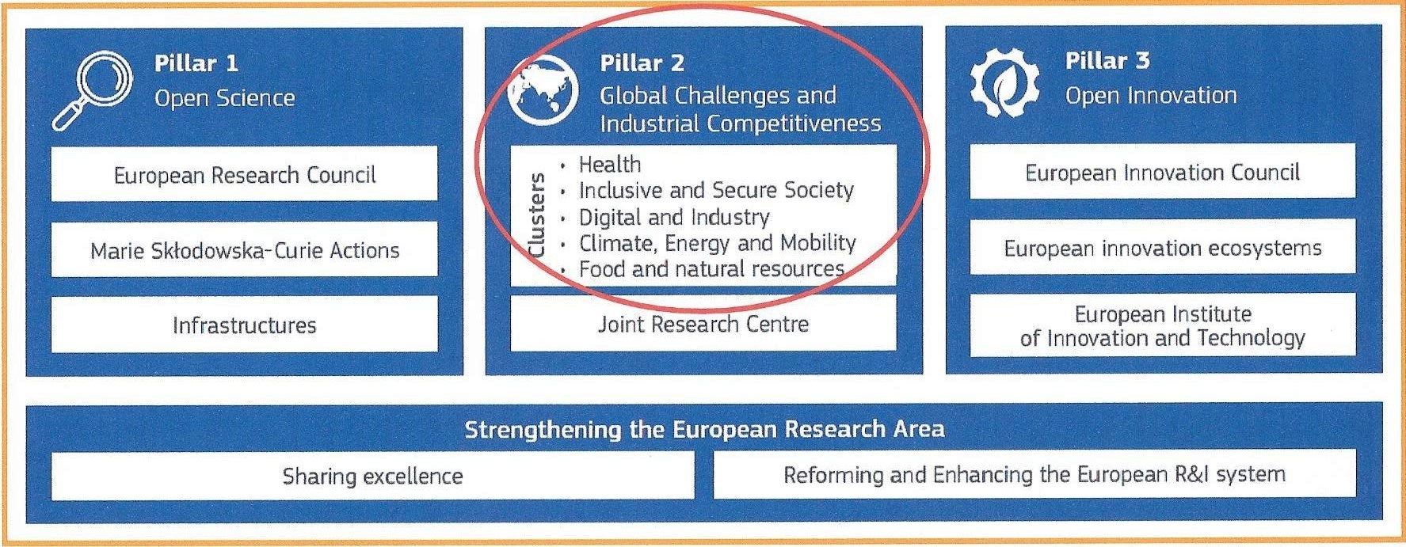
Glycoscience research: how do we obtain the
funding required within the EU Bioeconomy?
3.2: We must identify with key targets laid down within Horizon Europe, and show
how and why a substantial investment in glycoscience and glycotechnology will meet
the specified targets….

Slide 30
A total of €52,700,000,000 is currently allocated to:
“Pillar 2 – Global Challenges
& Industrial Competitiveness” in six tranches or “Clusters”……
Answer - Key Targets within Clusters!
2: We must identify with key targets laid down within Horizon Europe, and show
how and why a substantial investment in glycoscience and glycotechnology will meet
the specified targets….

Slide 31
Of these five Clusters, we can argue cogently that
glycoscience and glycotechnology are directly relevant to
THREE and indirectly relevant to the ONE of the others……
RELEVANT?
YES
NO
YES
PARTIALLY
YES

Slide 32
Of these five Clusters, we can argue cogently that
glycoscience and glycotechnology are directly relevant to
THREE and indirectly relevant to the ONE of the others……
5/6
0/6
7/9
2/9
6/7

Slide 33
Horizon Europe Partnerships that are relevant for us to
target, where novel glycoscience structural insights
are needed……
PA1: “Faster development and safer use of health innovations for European patients and global health;
PA2: “Advancing key digital and enabling technologies and their use, including artificial intelligence and quantum computing;
PA3: “European leadership in metrology, including an integrated metrology system;
PA4: “Accelerated competitiveness, safety and environmental performance of EU air traffic, aviation and rail”;
PA5: “Sustainable, inclusive and circular bio-based solutions;
PA6: “Clean hydrogen and sustainable energy storage, technologies with low environmental footprint and less energy-intensive production;
PA7: “Clean, connected, cooperative, autonomous and automated solutions for future mobility demands of people and goods;
PA8: “Innovative and R&D-intensive SMEs”.

Slide 34

Glycoscience research: how do we obtain the funding required within the EU Bioeconomy?
3.3: We must involve interested parties, including the general public, to show them
why investment in the glycosciences and glycotechnologies is in their interest and to
their benefit. An organisation is in place to do this, called CarboMet…..
“CarboMet” is a four-year Collaborative Support Action which aims to bring the importance and relevance of glycometrology to the attention of the European Community for the improvement of medical care, healthy eating and the manufacture of precision medicines. It is funded under Horizon 2020 (FET) and is led from the Manchester Institute of Biotechnology at Manchester University…… we are building a Roadmap of topics and actions and welcome anyone to join our network and get involved in our activities. The aim of the Roadmap is to get the subject of novel glycoscience squarely to the forefront of Horizon Europe thinking by mobilizing the glycoscience community Europe-wide.
Metrology of Carbohydrates
for
Enabling European BioIndustries
Principal Investigator Professor Sabine Flitsch, MIB, University of Manchester, UK
sabine.flitsch@manchester.ac.uk

Slide 35

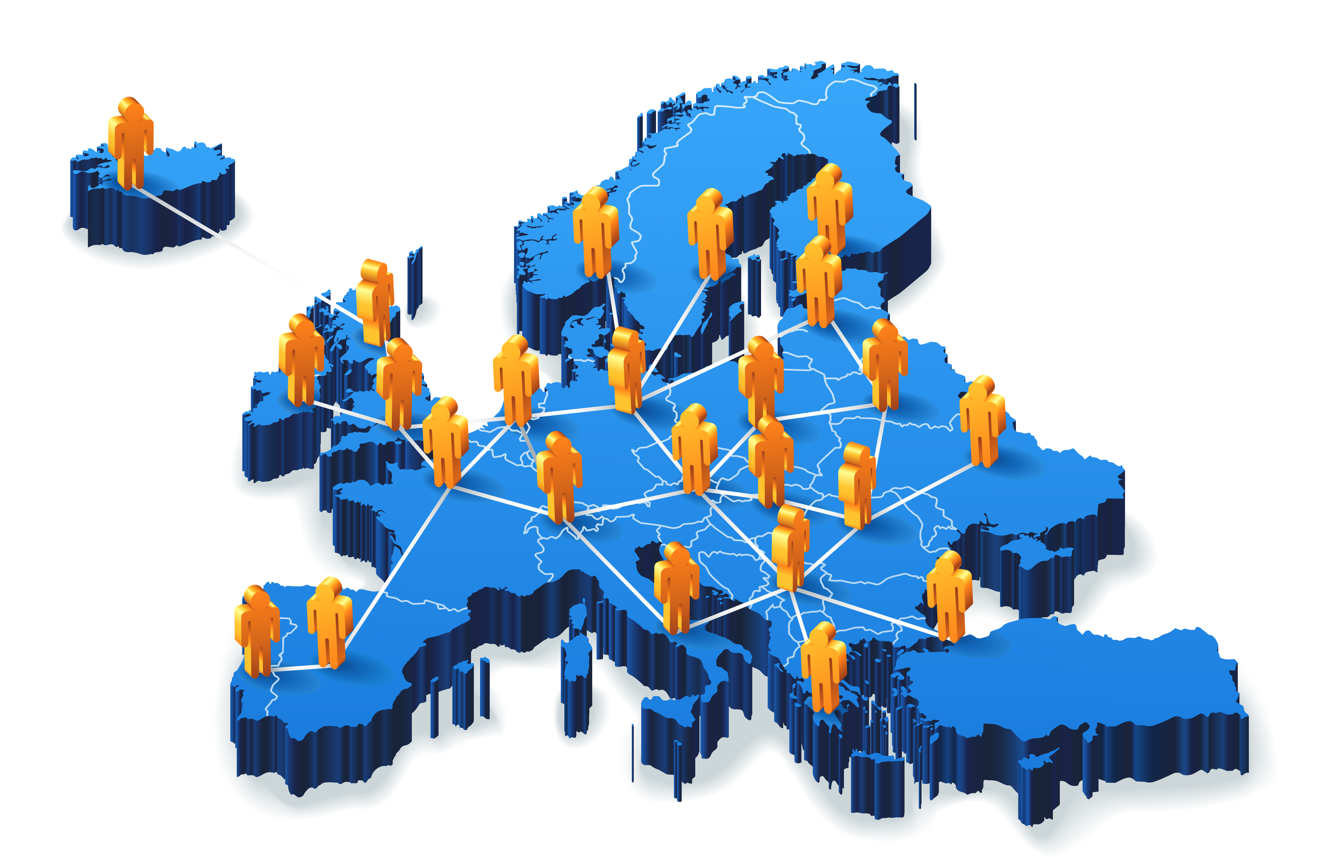
CarboMet facilitates engagement between key players and
stakeholders to ensure full engagement of the glycoscience
community across Europe…..
Examples of Key
Outputs
 |  | BioIndustry Sector (BIS)
 |  | Biopharmaceuticals including vaccines, antimicrobials, antibodies and hormones | Diagnosis of disease for development of Precision Medicines | Healthy Living: Food & Personal Care | Carbohydrates as Sustainable Materials
Enabling Technology Area (ETA) | Analytics , Soft Sensors and Measurements
 | Synthesis of Standards
 | Bioinformatics & Databases
Key
Enabling Technologies
CarboMet stakeholder input

Slide 36
CarboMet facilitates engagement between key players and
stakeholders to ensure full engagement of the glycoscience
Community across Europe…..please join us!
Scoping workshops:
EuroCarb 2017 conference, Barcelona, July 2017
Three glycotechnology topics were chosen as a start:
  Polysaccharide based vaccines;
  Precision diagnosis of disease;
  The role of dietary carbohydrates in maintaining a healthy gut microbiome.
Follow up workshops then followed:
Polysaccharide Based Vaccines, Milan, March 2018 - Positioning paper published – contact syed.ahmed-3@manchester.ac.uk )
The Role of Dietary Carbohydrates in the Gut Microbiome, Brussels, 7-8 June 2018 Positioning paper published – contact syed.ahmed-3@manchester.ac.uk )
Glycoinformatics Masterclass, 15 July 2018, ICS 2018, Lisbon
‘Carbohydrate – Tools for Synthesis & Analysis’, 28 Aug 2018, EuChemS , Liverpool
Carbohydrate-based Materials Workshop, Grenoble, 24-25 January 2019 (Positioning paper in preparation)
‘Frontiers in Glycoscience’, ESBOC meeting, Gregynog, 17-19 May, 2019

Slide 37
4. An example of Research and Innovation [‘R&I] priorities and challenges involving the glycosciences….
CarboMet is about metrology per se: CarboMet is
examining in particular the challenges involved, and
the supporting IT support systems required (the
‘Digital Economy’ in Horizon Europe terms). We are
proposing possible research programmes that will be
needed to meet these challenges.

Slide 38
CarboMet facilitates engagement between key players and
stakeholders to ensure full engagement of the glycoscience
community across Europe…..
Examples of Key
Outputs
 |  | BioIndustry Sector (BIS)
 |  | Biopharmaceuticals including vaccines, antimicrobials, antibodies and hormones | Diagnosis of disease for development of Precision Medicines | Healthy Living: Food & Personal Care | Carbohydrates as Sustainable Materials
Enabling Technology Area (ETA) | Analytics , Soft Sensors and Measurements
 | Synthesis of Standards
 | Bioinformatics & Databases
Key
Enabling Technologies
CarboMet stakeholder input

Slide 39
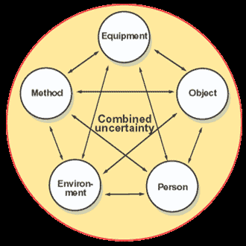
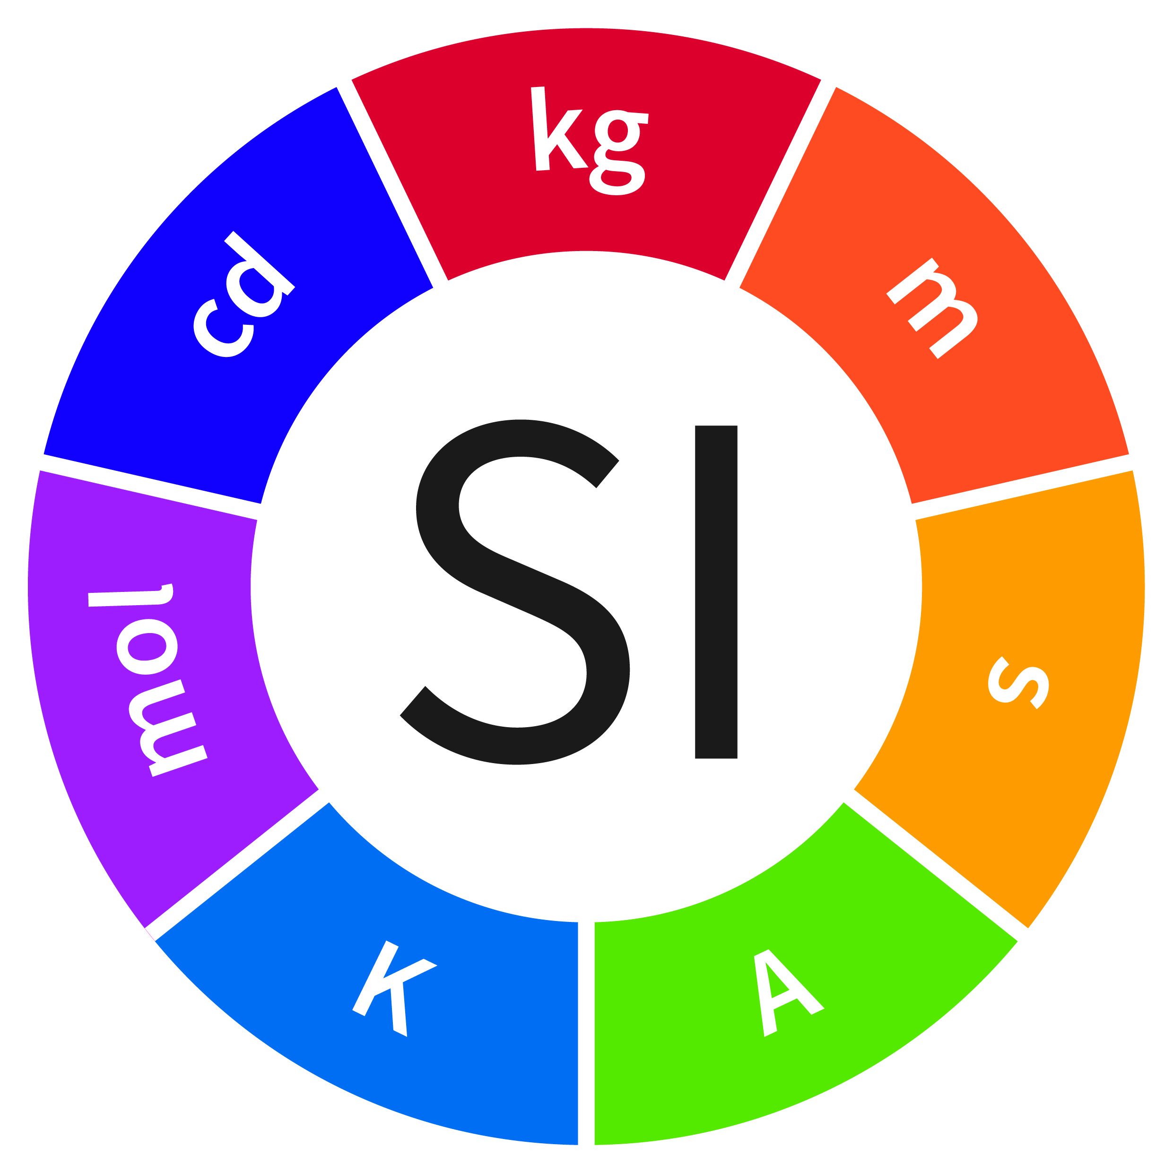
Metrology – what is it?
Metrology is NOT the same as new measurement techniques!…
It is about the scientific study of measurement. It includes conformance to international specifications and/or technical requirements and the concomitant development of standards….
…because to achieve comparability of results over space and time, it is essential to link all measurement results to a common, stable reference or measurement standard.
Results can then be compared through the quantified relationship to that measurement standard.
The linking of results in this manner is termed traceability.

Slide 40
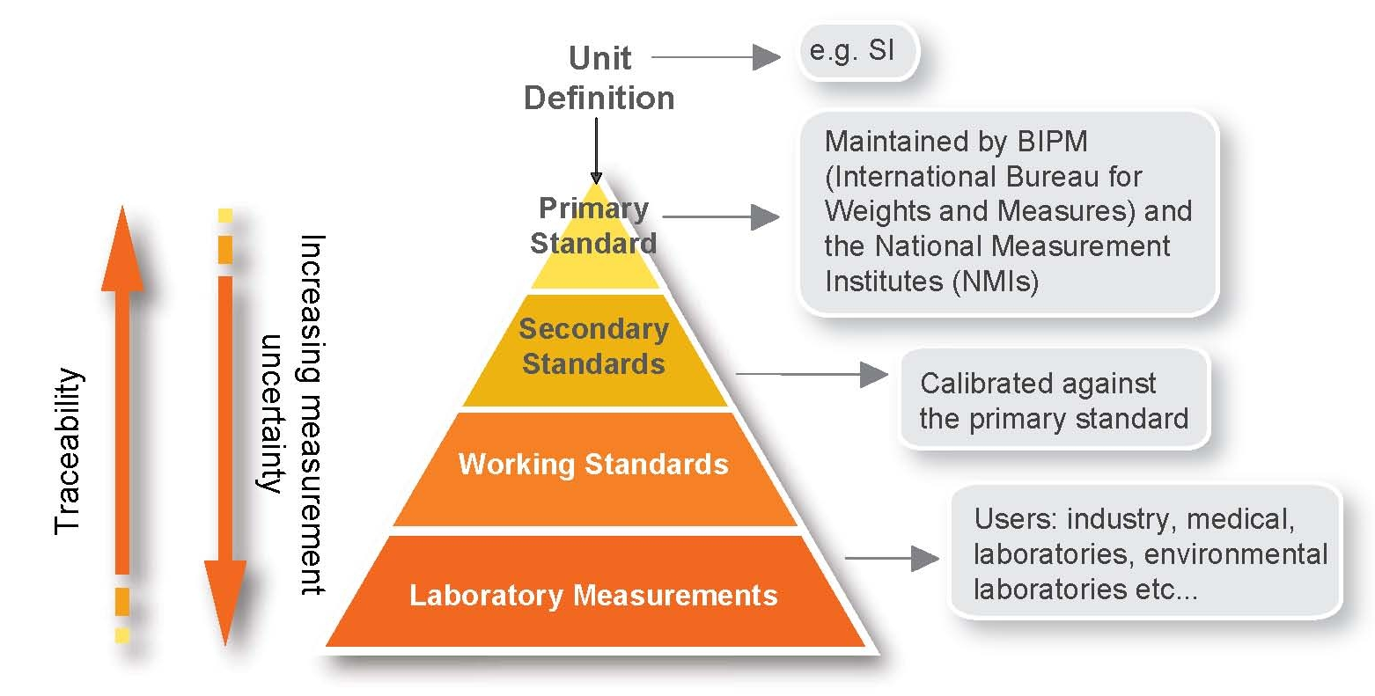
….but why should metrological standards matter to us?
…because they are critical for product
specification and quality, safe
medical treatments, good food
products and sound agricultural
practices, all developed sustainably
and reliably….
A measurement in (e.g.) Japan should give the same result as one in Europe on the same sample. This is KEY to QUALITY CONTROL in MANUFACTURING (i.e., safety, consistent and guaranteed performance, the genuine article, no contamination, etc. ) – key to safe medicines, foods, etc .

Slide 41
We aim to build a bio-informatics database of real utility to those who work on glycoscience and glycotechnology and better metrology and sound theory to enable this….
Examples of Key
Outputs
 |  | BioIndustry Sector (BIS)
 |  | Biopharmaceuticals including vaccines, antimicrobials, antibodies and hormones | Diagnosis of disease for development of Precision Medicines | Healthy Living: Food & Personal Care | Carbohydrates as Sustainable Materials
Enabling Technology Area (ETA) | Analytics , Soft Sensors and Measurements
 | Synthesis of Standards
 | Bioinformatics & Databases
Key
Enabling Technologies
CarboMet stakeholder input

Slide 42
Question: has the rise of “big data” meant that we no longer need to understand chemical structure elucidation and reaction mechanisms?
“Data abound now more than
ever and the speed at which
they accumulate is accelerating:
according to IBM, 10²¹ bytes of
digital data are now available…”
“Technology provides the computational
resources (high performance computing,
cloud services, distributed and parallel
computing, etc.) required to process
large amounts of data by using
advanced analytics platforms
(the third enabler) by turning
them into actionable
Information in useful time…
Isn’t this all we need?
”
The answer to the
question posed
above is an
emphatic “NO”!
“Big data need big theory too”
[From “Industrial Process Monitoring in the Big Data/Industry 4.0 Era:
From Detection, to Diagnosis, to Prognosis”,
M.S.Reis & G.Gins, Processes 2017, 5, 35]

Slide 43
“Big data” are not a magic shortcut!
Coveney PV, Dougherty ER and Highfield RR, Phil.Trans.R.Soc.A374: 20160153.

Slide 44
Lots of data are not a substitute for understanding – we need information on the chemical mechanisms underpinning glycan behaviour to interpret the data….
That is, we need rigorous data analytics….
We need to define relationships based on structural and rigorous mechanistic understanding [i.e., x = f (T, p, t )], describing how one property varies when other properties change in value;
We need to define how extensive properties (such as m, V, q, A ) and intensive properties (such as T, p, μ, V) can be used most effectively and accurately in the design of novel sensors;
We need to design built-in self-learning algorithms that evolve and refine in a cognitive manner (so-called “AI”)….
…this requires detailed knowledge of glycoscience structure and reactivity based on sound theory, which in turn must be based ON ACCURATE METROLOGY.

Slide 45
So let’s not over-promise. Many other disciplines are facing similar challenges……
…and the need for good metrology and the measurement
indeed lies in the “big data”…but the data banks, the
computations and the analytics are
only as good as the accuracy of the
measurement and metrology used.
Perhaps an obvious point! - but one
that needs to be emphasised as we
press for greater funding support from
Horizon Europe. We need more than ever
to operate across many industry sectors and
traditional disciplinary boundaries to succeed!
.
[From “Industrial Process Monitoring in the Big Data/Industry 4.0 Era:
From Detection, to Diagnosis, to Prognosis”,
M.S.Reis & G.Gins, Processes 2017, 5, 35]

Slide 46
Purposes of this talk
We have considered why the emphasis on an expanding EU Bioeconomy makes this a uniquely opportune time to be working on glycoscience and glycotechnology in Europe.
We have outlined how the EU and in particular Horizon Europe is presently thinking about the Bioeconomy as a solution to many current Global Challenges.
We have described some ways that we can use to increase the profile of new glycoscience and glycotechnology with the general public and governments within Europe. ….
…and specified ways we can raise Research and Innovation funding for glycoscience and glycotechnology in the next decade within Europe.
Finally, we have discussed some already identified ‘R&I’ cross-sector and multidisciplinary challenges we must overcome in glycoscience and glycotechnology by working across boundaries.

Slide 47
The Bioeconomy and Glycoscience
Global Challenges Science Week
Université de Grenoble Alpes
Rodney Townsend
6th June 2019

